Slide 1




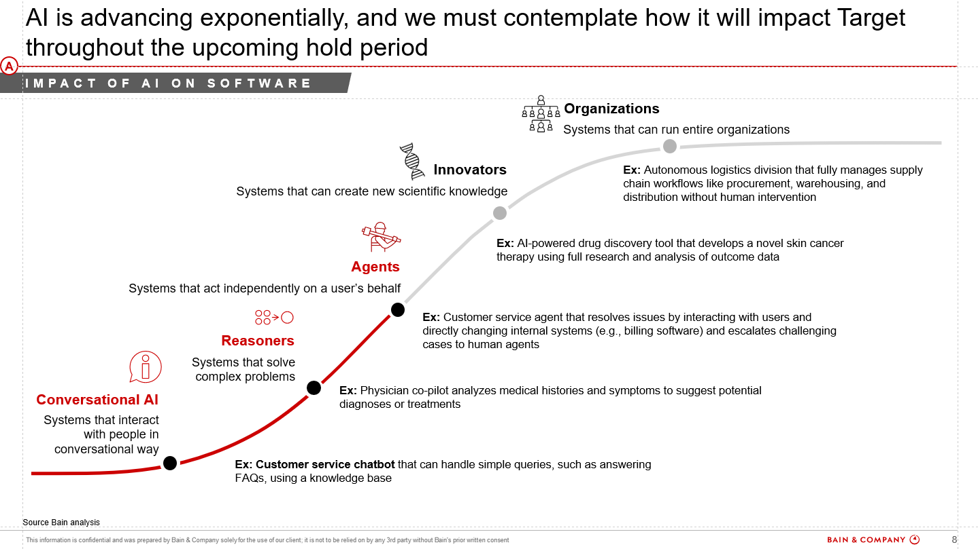
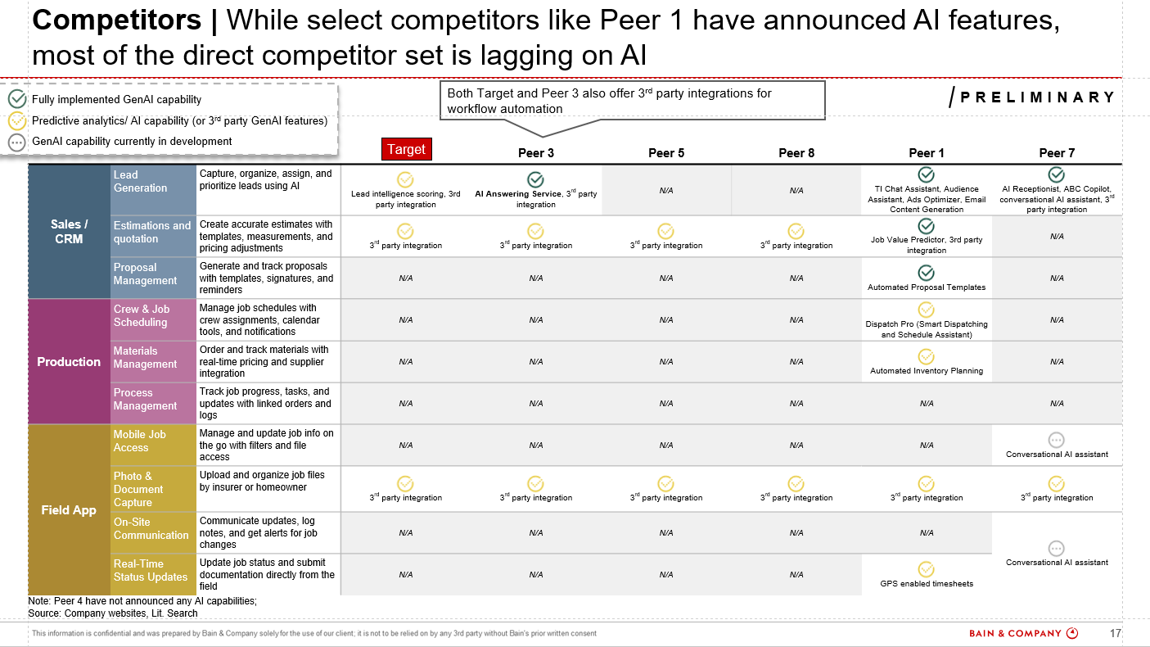
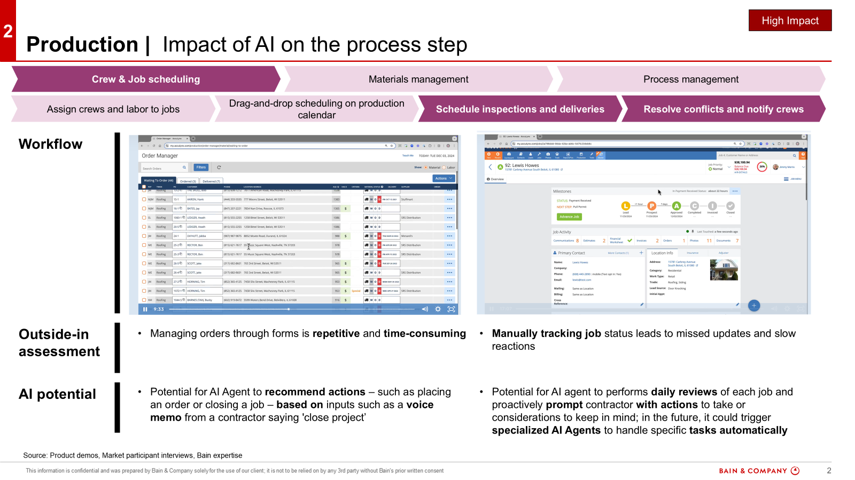
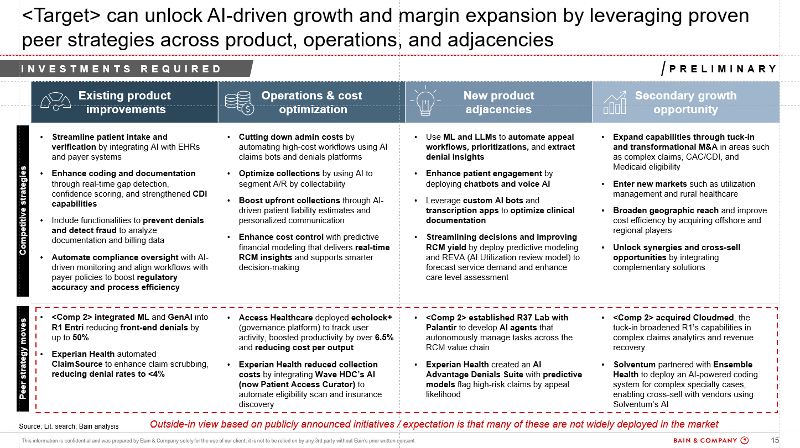
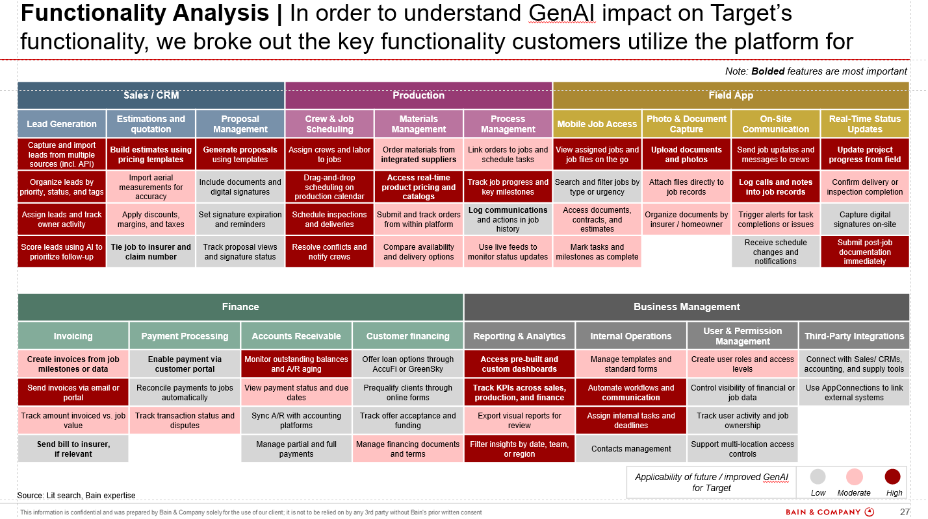
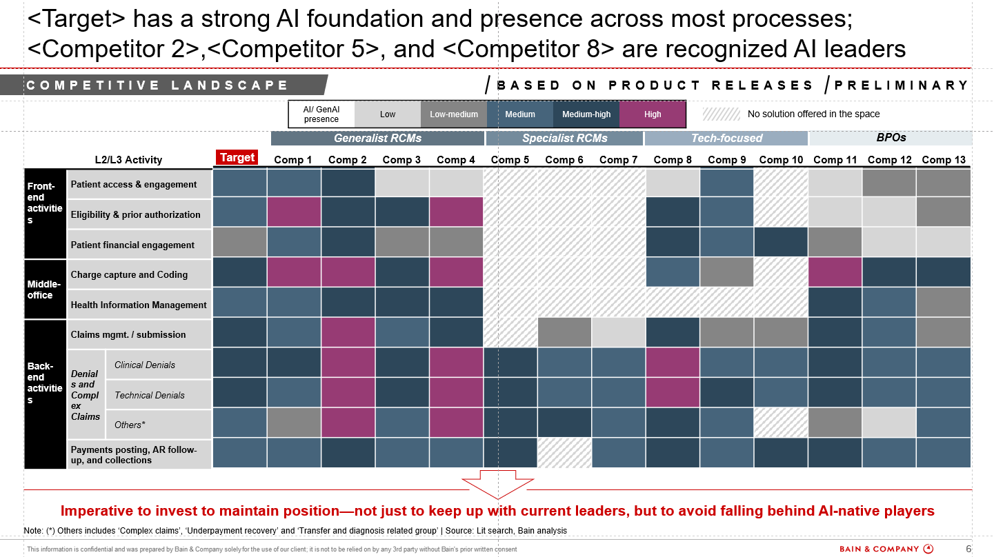
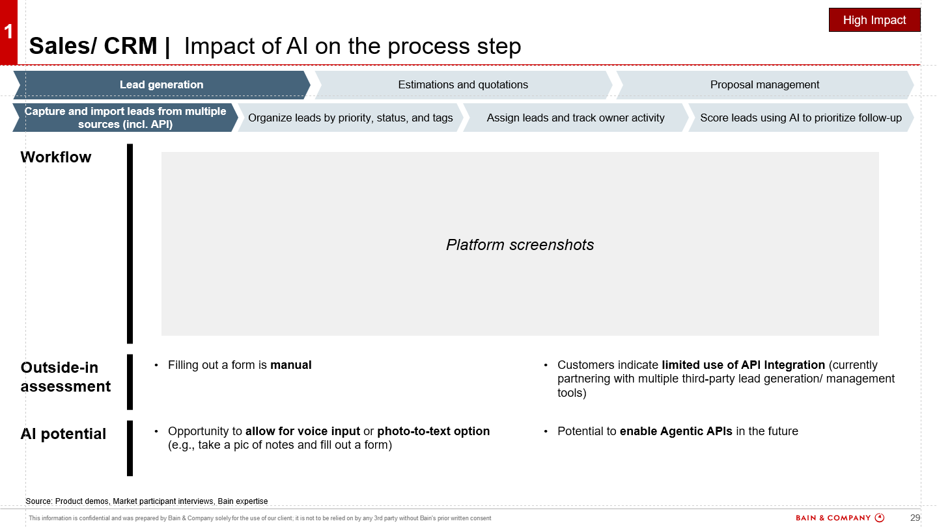
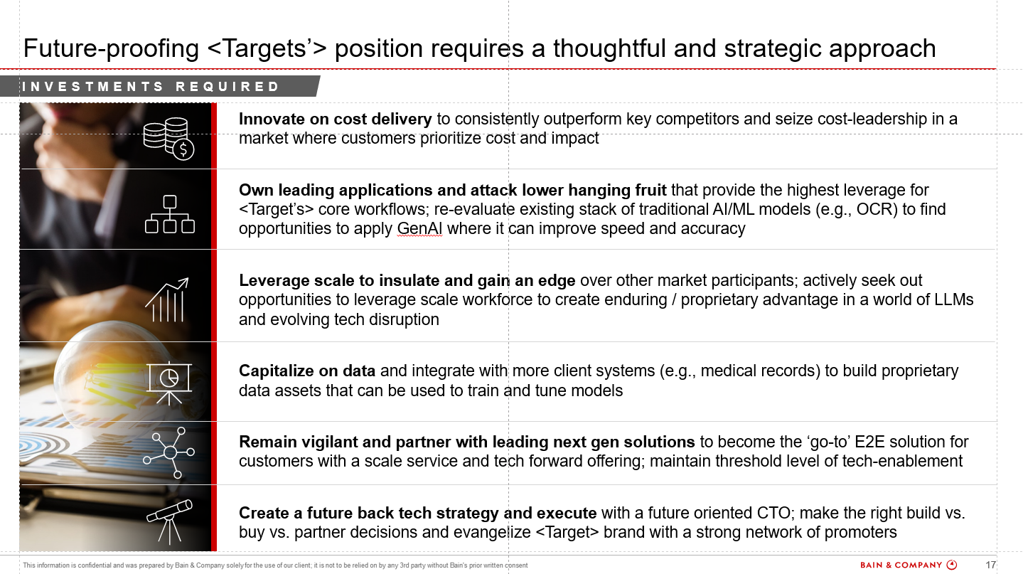
EXECUTIVE SUMMARY
AI impact and adoption
Competitive scan and benchmarking
AI tech replicability
Future strategy and roadmap
Assess how GenAI disrupts industry dynamics and the customer journey, identifying future use cases, adoption drivers, risks, and integration paths
Analyze AI moves by major competitors, including incumbents and disruptors. Benchmark target performance and track evolving trends to pinpoint threats and whitespace
Test how easily the target’s tech can be replicated through quick-build AI prototypes. Validate defensibility and real-world relevance of key use cases
Develop an AI-aligned roadmap based on current positioning. Anticipate market shifts and define a clear, phased path to scalable AI adoption

